Slide 1



3
Unit 5 Section A
Will you be a worker or a laborer?
FOREIGN LANGUAGE TEACHING AND RESEARCH PRESS
AIR FORCE ENGINEERING UNIVERSITY
FOREIGH LANGUAGE TEACHING AND RESEARCH PRESS
AIR FORCE ENGINEERING UNIVERTISY

Slide 2
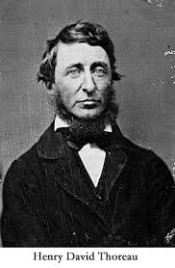
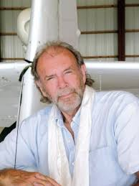
3
5
When work is a pleasure
UNIT
Do not hire a man who does your work for money, but him who does it for love of it.
—Henry David Thoreau (American philosopher)
The more I want to get something done, the less I call it work.
—Richard Bach (American writer)

Slide 3

^{Section A}
3
5
When work is a pleasure
UNIT
Will you be a worker or a laborer?
Objectives
To talk about work
To further understand the text
To apply the phrases and patterns
To master the essay writing skill

Slide 4
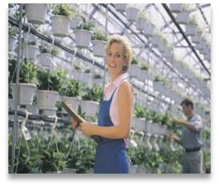




A
Will you be a worker or a laborer?
SECTION
Contents
Warming-up Activities
Text Study
Language Application
Summary

Slide 5
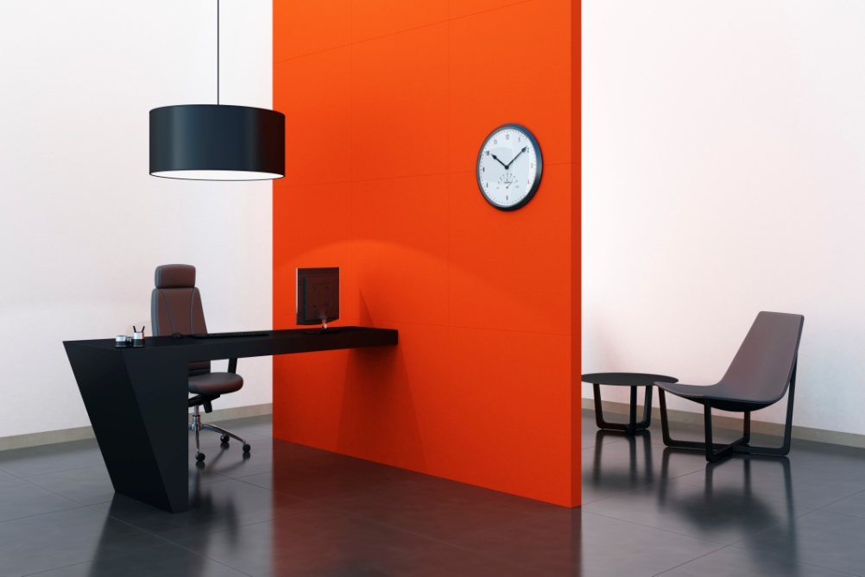


A
Will you be a worker or a laborer?
SECTION
Warming-up Activities
Lead-in
Pre-reading Activities
Cultural Background

Slide 6

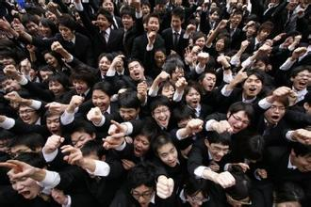
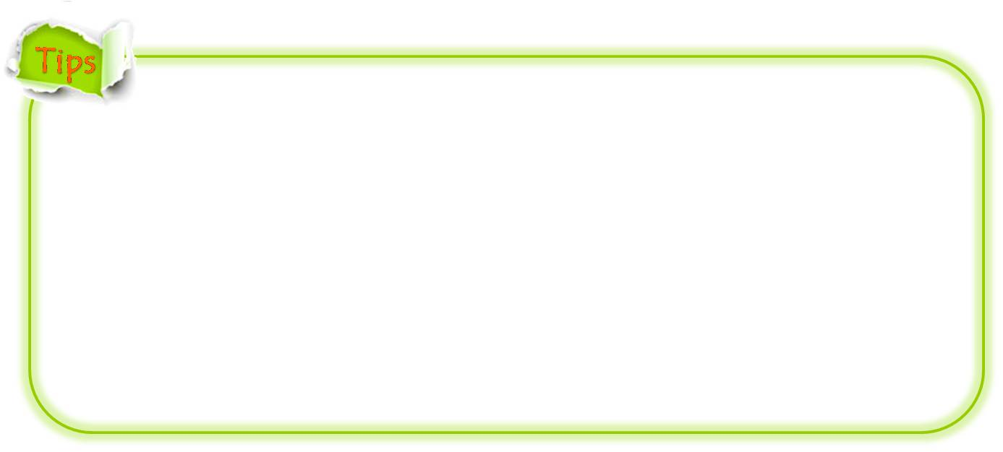
1. What do you pay special attention to when looking for in a job?
High salary and attractive benefits
Bright future of career growth
Less work pressure
Flexible working time
Achievement of self-realization
…

Slide 7

2. What does work mean to you?
Just means of living
Measured in terms of social status
Realization of one’s dream
Self-improvement
…

Slide 8

1. Read the typical job characteristics below and write down the number that represents your opinion.
□ 1.The chance of advancing to a higher position.
□ 2.How much the job pays.
□ 3.How much responsibility the job involves.
□ 4.The stress level of the job.
□ 5.The location of the office building.
1 = disagree completely
2 = agree a little
3 = agree to some extent
4 = mostly agree
5 = agree completely

Slide 9
1. Read the typical job characteristics below and write down the number that represents your opinion.
□6. The work conditions.
□7. Whether the job requires unusual work hours.
□8. The amount of travel required.
□9. Whether the job fits my personality.
□10. Whether people consider the job prestigious.
1 = disagree completely
2 = agree a little
3 = agree to some extent
4 = mostly agree
5 = agree completely

Slide 10
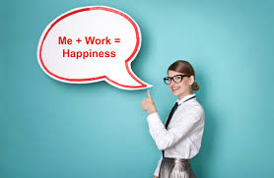
2. Work in pairs and compare your answers. Discuss the following questions with your partner.
What are the three most important factors when you choose a job?

Slide 11

3. What are the three most important factors when
you choose a job?
There are many things to consider when people are choosing a career. But for me, the following three factors affect my choice most. First, the job must fit my personality. I believe that certain occupations are more suitable for particular personality types than others. If the job really fits my personality, I will be more likely to be successful and will enjoy going to work. Second, how much the job pays.
To be continued

Slide 12
3. What are the three most important factors when
you choose a job?
It is understandable that if I want to live an adequate life, I need to make enough money to support that standard of living. Finally, the location of the office building is also an important factor in choosing a career for me. I don’t like a job that is located far away from my home, because it requires extra commute time and will surely reduce the quality time I could otherwise have spent with my family.

Slide 13



Listen to a short passage concerning American’s Work Ethic and fill in the missing information.
For four hundred years or more, one thing has been a characteristic of Americans. It is called their “work ethic”. Its _____ were in the teaching of the Christian Puritans who first settled in what is now the northeastern state of Massachusetts. They believed that is was their _____ duty to work as every task to please God by their diligence, honesty, _________________, skill, and attitude.
roots
moral
attention to details
To be continued

Slide 14
Listen to a short passage concerning American’s Work Ethic and fill in the missing information.
To these Puritans, it was a sin to be lazy or to do less than your best in any task. They and later Americans tried to follow the Bible’s _________. “If a man will not work, he shall not eat.”
Therefore, Americans have for ________ believed that they were guilty of sin if they did not work as carefully and hard as they could when they did anything.
teachings
centuries
To be continued

Slide 15
Listen to a short passage concerning American’s Work Ethic and fill in the missing information.
God would ______ those who were careless or lazy in their work. Even as children they were taught, “If it’s worth doing at all, it’s worth doing well.”
But some people have gone beyond the usual ________________. They are especially attracted to the notion of “climbing the ladder” so as to increase their status, _______________, and sense of
self-worth.
punish
sense of diligence
financial position
To be continued

Slide 16
Listen to a short passage concerning American’s Work Ethic and fill in the missing information.
In English a new world has been created to describe people who work compulsively. The word “workaholic” describes an individual who is as _______________ as an alcoholic is to alcohol.
There are __________ points of view about workaholics. Those concerned with problems of mental stress believe workaholics ______ themselves physically and mentally.
addicted to work
conflicting
abuse
To be continued

Slide 17
Listen to a short passage concerning American’s Work Ethic and fill in the missing information.
Others hold that workaholics are valuable members of society because they are ___________________. The American culture values achievement, efficiency, and production, and a workaholic _______ these values.
extremely productive
upholds

Slide 18
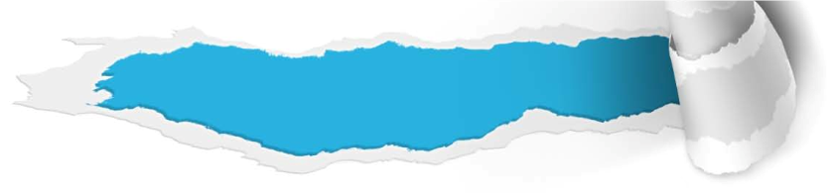

Cultural Background
Questions previewing
1. What is “continuing education”?
Tips
2. What is “experiential learning”?
Tips

Slide 19

Cultural Background
1. What is “continuing education”?
Continuing education refers to the education for adults, usually in classes that are held in the evening and especially on subjects that are related to their jobs.

Slide 20
Cultural Background
2. What is “experiential learning”?
Experiential learning is the process of making meaning from direct experience.
It is learning through reflection on doing, which is often contrasted with rote learning (死记硬背).
Experiential learning focuses on the learning process for the individual.
To be continued

Slide 21
Cultural Background
2. What is “experiential learning”?
An example of experiential learning is going to the zoo and learning through observation and interaction with the zoo environment, as opposed to reading about animals from a book.
Thus, one makes discoveries and experiments with knowledge firsthand, instead of hearing or reading about others’ experiences.

Slide 22


A
SECTION
Will you be a worker or a laborer?
Text Study
Main Idea & Structure
Language Focus
Critical Thinking

Slide 23


According to the writer, how can a person be truly happy?(Para. 1)
Tips
To be truly happy, a person must feel _________________. People are never happy if they _____________ by society to do work they do not enjoy, or if what they do enjoy is ignored by society as having no _____ or __________ .
free and important
feel compelled
value
importance

Slide 24

How is labor different from play? (Para. 2)
Tips
People are considered ________ if their job has an _______ effect on them, yet they feel compelled to continue working because of ___________________ and the need to ________ their family. The opposite of labor is _____ which is a purely ______________; society does not care when or whether we play.
laborers
adverse
societal expectations
support
play
private pastime

Slide 25

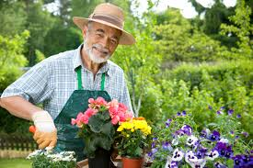

Between labor and play stands _____. (Para. 3)
work
gardener
worker
city mayor
laborer

Slide 26

Why does the author make a comparison between a gardener and a well-dressed city mayor? (Para. 3)
Tips
The author wants to show that the difference
between workers and laborers does not lie in the _______________ (工作的性质) itself, be it mental or manual, of low or high esteem, but in whether a person has an _______ (兴趣) in his job.
nature of the job
interest

Slide 27


Introduction
Part I : (Paras. 1 – 3 )
The introduction part, includes the first three paragraphs, providing a framework to differentiate among work, labor, and play.

Slide 28
Section 1 (Para. 4): Workers and laborers are different in their _______ toward their work.
attitude
Body
Section 2 (Para. 5):
Workers and laborers differ in the amount of ___________ they derive from their jobs.
Part II: (Paras.4 – 8)
satisfaction
Section 3 (Paras. 6 – 8):
In modern times, workers and laborers spend their __________ in different ways.
leisure time

Slide 29
What does leisure mean to workers and laborers respectively? (Para. 4)
To workers: leisure means simply the hours they need to ________ ____ in order to work efficiently.
To laborers: leisure means ________ from compulsion.
freedom
relax and
rest
prone to dedicate more time to working
imagine that the more hours they have free for play, the better

Slide 30
How do workers and laborers differ in the amount of personal satisfaction they derive from their jobs? (Para. 5)
Workers:
Laborers:
be happier
less stressed
more satisfied
work with more diligence and precision
a sense of personal pride
daily grind
wasting the time
no contribution to their happiness
meaningful time:
spent in leisure and play
Unfortunately, laborers are all too commonplace, and only a small percentage of the population is in the lucky position of being workers.

Slide 31
(Para. 6) While social development has created much more leisure time than ever before, modern laborers spend their leisure time in ________________.
Lifelong learning
(Para. 7) ______________ can make the difference between being bored, unhappy laborers and workers who find meaning and joy in their employment and life.
fostering bad habits
In modern times, workers and laborers spend their leisure time in different ways.
(Paras. 6 – 8)
(Para. 8) Workers, unlike laborers, hurl their _______ into their work, be it physical or mental.
passion

Slide 32
Conclusion
Part III (Para. 9)
The conclusion part summarizes that everyone has to find a job and
earn a living, and that whatever job you choose, you must contend with this essential question: Will you be a laborer or a worker?

Slide 33


Everyone has to find a job and earn a living. (Para. 9)
slave away at a job
wait all day until they go home and play.
Whatever job you choose, you must
contend with this essential question:
Will you be a laborer or a worker?
energized and focused
take optimum pleasure in the task at hand
a simultaneous sense of purpose and enthusiasm

Slide 34

Introduction (Paras.1 – 3):
What are work, labor, and play?
To be truly happy, a person must feel both free and important. (Para. 1)
Labor is the polar opposite of play. (Para. 2)
Between labor and play stands work. (Para. 3)

Slide 35
Body (Paras.4 – 8):
Workers and laborers are different in many aspects.
People’s attitude toward their work determines everything. (Para. 4)
People differ in personal satisfaction they derive from their jobs. (Para. 5)
In modern times, workers and laborers spend their leisure time in different ways. (Paras. 6-8)

Slide 36
In modern times, workers and laborers spend
their leisure time in different ways.
(Paras. 6-8)
There is more leisure time today than
ever before and laborers foster many bad habits. (Para. 6)
Actually, there are many opportunities
to improve people’s minds and their
working conditions. (Para. 7)
People who enjoy their work find time
passes quickly. (Para. 8)

Slide 37
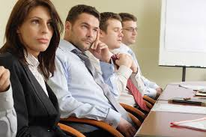
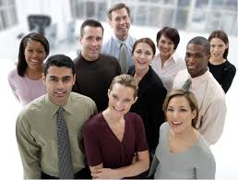
Conclusion (Para. 9):
Whatever job you choose, you must contend with this essential question:
Will you be a laborer or a worker?

Slide 38

Will you be a worker or a laborer?
The text argues, by differentiating among work, labor, and play, that interest and _________ in work are important for the benefit of both __________ and society.
There are three major differences between workers and laborers. Firstly, workers and laborers are different in their _______ toward their work. Workers will dedicate more time to ________ and spend less time on leisure,
enjoyment
individuals
attitude
working
To be continued

Slide 39
whereas laborers will regard leisure as __________ from compulsion and the more hours they have free for play, the better. Secondly, workers and laborers differ in the amount of ___________ they derive from their jobs. Workers will achieve greater ___________ than laborers. Thirdly, in modern times, workers and laborers spend their ___________ in different ways.
autonomy
satisfaction
happiness
leisure time
To be continued

Slide 40
While social development has created much more leisure time than ever before, modern laborers spend their leisure time in fostering __________. Considering this phenomenon, _______________ can make the difference between being bored, unhappy laborers and workers who find meaning and joy in their ___________ and life.
bad habits
lifelong learning
employment
To be continued

Slide 41
Moreover, workers, unlike laborers, hurl their _________ into their work, be it physical or mental.
Everyone has to find a job and
____________, and that whatever
job you choose, you must ____________ this essential question: Will you be a laborer or a worker?
passion
earn a living
contend with

Slide 42
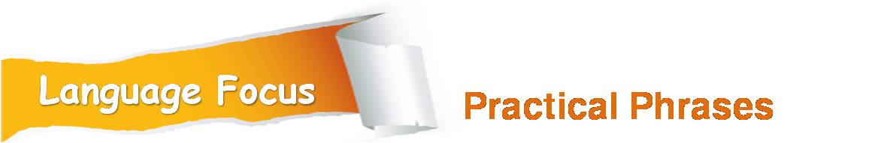
Practical Phrases | Specific Meanings
1. name only / but a few | 略举几例
2. sink one’s teeth into sth. | 专注于做某事
3. slave away | 拼命干；苦干
4. count down | 倒数；倒计时
5. at hand | 手头的；需要马上处理的
6. contend with sth. | 必须处理；不得不应付

Slide 43

略举几例
短语逆译
name only / but a few
短语应用
国际社会也在提供援助，略举几例，如美国、法国和中国。
意群提示
(to name only / but a few)
The international community is also offering
assistance, including the United States, France
and China, to name only a few.

Slide 44
专注于做某事
短语逆译
sink one’s teeth into sth.
短语应用
维多利亚女王这个角色，就是为你而设，是一个你能倾情投入的角色。
意群提示
(sink one’s teeth into sth)
Playing the part of Queen Victoria is the kind of
role that is made for you, the kind of role you
can sink your teeth into.

Slide 45
拼命干；苦干
短语逆译
slave away
短语应用
辛辛苦苦用电脑键盘输入后，你还得按老办法手工写上注释符号。
意群提示
(slave away/notation signs/old-fashioned)
After slaving away at the computer keyboard,
you then still have to write notation signs by
hand, the old-fashioned way.

Slide 46
倒数；倒计时
短语逆译
count down
短语应用
一块巨大的电子显示屏对即将在此举行的泛美
运动会进行倒计时。
意群提示
(count down / Pan-American Games)
A giant electronic display is counting down the days to the start of the Pan-American Games here.

Slide 47
手头的；需要马上处理的
短语逆译
at hand
短语应用
如果他们花上一点时间去弄懂手头的题目，则极有可能不需要计算器就能找到一个简单的答案。
意群提示
(at hand/ most likely )
If they would take a few seconds to understand
the problem at hand, they would most likely find
an easy answer and without needing a calculator.

Slide 48
必须处理；不得不应付
短语逆译
contend with sth.
短语应用
当第一个财年结束时，欧洲迪斯尼乐园不得不去应对很多的困难。
意群提示
(contend with/ financial year )
Euro Disney had to contend with many difficulties when its first financial year came to an end.

Slide 49

Functional Patterns | Functions & Usages
What is sth. from the point of view of A is sth. else from the point of view of B. | 用于表达“不同的人对待同一件事有不同的看法”。
Sb. hurl the passion into sth. Or doing sth., be it… like/such as…, or…like/such as … | 用于举例说明“某人执着地做某事”。
But while A is doing sth., B is doing sth. else. | 用于对比“不同人不同的做事风格”。

Slide 50
原句译文
社会上看来一定是苦工的事情对个人来说却是自在的玩乐活动。
逆译练习
What is necessary labor from the point of view of society is voluntary play from the individual’s personal point of view. (Para. 3)
句型提炼

Slide 51

句型提炼
What is sth. from the point of view of A is sth. else from the B’s point of view.
应用提示
用于表达“不同的人对待同一件事有不同的看法”。
句型应用

Slide 52
典型例句
在老年人看来是怪异的打扮对年轻人来说却是时尚。
意群提示
(elderly people/weird dressing)
What is weird dressing from the point of view of elderly people is fashion from the point of view of young people.

Slide 53
原句译文
无论是铁匠的体力活，还是像科学家或艺术家从事的偏脑力的活，他们在工作中都会投入激情。
逆译练习
They hurl their passion into their work, be it physical like the work of a smith, or more mental like that of a scientist or an artist. (Para. 8)
句型提炼

Slide 54
句型提炼
Sb. hurl the passion into sth. or doing sth., be it… like/such as…, or… like/such as …
应用提示
用于举例说明“某人执着地做某事”。
句型应用

Slide 55
典型例句
公众为我们的事业捐款，为灾难受害者捐款，无论是地震之类的自然灾难，还是石油泄漏之类人为之灾。
意群提示
(donate money / oil spills)
The public hurl their passion into donating money to our cause and for the victims of disasters, be it natural, such as earthquakes, or man-made, such as oil spills.

Slide 56
原句译文
但是当劳役者倒数着时间之时，工作者则干劲十足，全神贯注，从手头的任务中享受到最大的快乐。
逆译练习
But while laborers are counting down the hours, workers are energized and focused, taking optimum pleasure in the task at hand. (Para. 9)
句型提炼

Slide 57
句型提炼
But while A. is doing sth., B is doing sth. else.
应用提示
用于对比“不同人不同的做事风格”。
句型应用

Slide 58
典型例句
但是当懒人在虚度光阴的时候，奋斗者则目标坚定、信心十足，在努力工作中品尝到成功的喜悦。
意群提示
(quitter/struggler/dawdle away one’s time)
But while quitters are dawdling away their time, strugglers are determined and confident, tasting the joy of success in their hard working.

Slide 59



a. In a society where slavery in
the strict sense has been abolished, the social indications around work, the value of work and the salary, have degraded many laborers into modern slaves – “wage slaves”. (Para. 1, L3)
在一个奴隶制度严
格说来已经被废除的社会里，工作的社会含义、工
作的价值和薪水，已经把许多劳役者降格为现代奴
隶——“薪奴”。

Slide 60
工作者喜欢自己的工作，感觉更快乐，更轻松，通常对自己的生活更满意。他们工作起来也会更勤奋，更精细，因为他们对自己的工作已经产生了一种自豪感。
b. Workers who enjoy their jobs will be happier, less stressed, and generally more satisfied with their lives. They will also work with more diligence and precision because they have fostered a sense of personal pride in their jobs.(Para. 5, L2)

Slide 61
c. On the other hand, laborers, whose sole incentive is earning their livelihood, feel that the time they spend on the daily grind is wasted and doesn’t contribute to their happiness. (Para. 5, L5)
相反，由于劳役者的唯一动力是挣生活费，他们觉得每天花在苦差上的时间是一种浪费，不会让自己快乐。

Slide 62
他们通过选择一份有益社会、成就自我的工作，怀揣着一种使命感和热情，提升了自己的整个生活。
d. By choosing a job that is both useful to society and personally fulfilling, workers maintain a simultaneous sense of purpose and enthusiasm that improves their whole lives.(Para. 9, L4)

Slide 63


1. How does technology change people’s work and life?
Tips
2. How can a person foster love for his work?
Tips
3. Will you be a worker or a laborer? Why?
Tips

Slide 64

How does technology change people’s work and life?
• New technology clearly enables us to work faster and more efficiently, and it facilitates flexible and remote working (fitting in with childcare or avoiding a distasteful commute), but it can also mean that we cannot ever really get away from our jobs and tune out.
• Technology may make us more responsive, more capable of gaining access to information over a broader spectrum. Technology is basically
to be continued

Slide 65
How does technology change people’s work and life?
• With new technology, we are working harder and are more enslaved to our work than before. We are walking around with laptops or with portable phones. We’re becoming slaves to high technology. There’s no escape.

Slide 66
How can a person foster love for his work?
• Start with a positive and right attitude, for the right attitude toward work makes it much easier to accept and do it.
• Put interest into work. Once you have the enthusiasm, it becomes easy to start things.
to be continued

Slide 67

How can a person foster love for his work?
• Create favorable surroundings when doing the work.
• Always reflect on what you have achieved, which will give you a sense of pride and fulfillment.

Slide 68
Will you be a worker or a laborer? Why?
• I will be a worker, for a worker is someone who has an interest in and a strong love for his work, who is more dedicated to and more satisfied with his work than a laborer would be.

Slide 69
Will you be a worker or a laborer? Why?
• I think it’s possible that I will choose to be a laborer someday. It’s never the case that we do anything completely in accordance with our own interest. We have to meet the expectations of the ones we love and we have to be the breadwinner for our family. Anyway, we shouldn’t ignore the needs and opinions of our family members when we are planning our careers.

Slide 70

Make a comparison and contrast between Chinese and American values involved in daily workplace.
Respect for authority or equality
(responses to decision-making)
Interpersonal harmony or competition
(facing divergences)
People orientation or problem orientation
(ways of dealing with problems)
Self-deprecating or self-presentational
(patterns of expressing viewpoints)
Being cautious or adventurous
(styles of making plans)

Slide 71


Watching & Discussing
Watch the two video clips of Modern Family and discuss the following questions.
Questions
Q1: Do you think Andy a qualified manny?
Q2: What do you think people will choose: a low-paid job one likes, or a boring well-paid job?

Slide 72
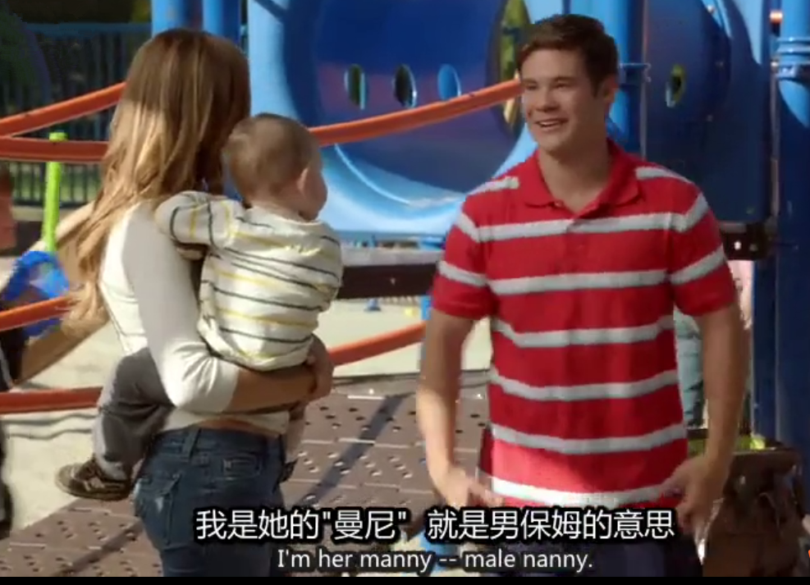
Watching & Discussing

Slide 73
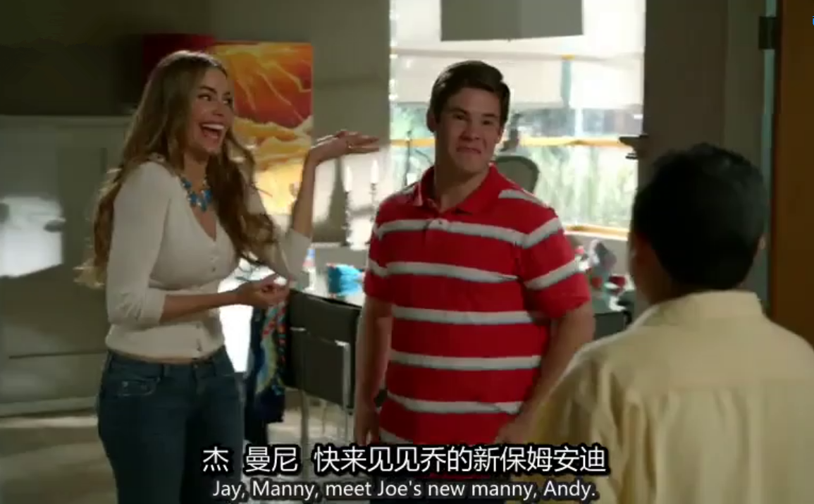
Watching & Discussing

Slide 74
Watching & Discussing
Q1: Do you think Andy a qualified manny?
professional experience working with kids
good at cooking and housework
a nutritionist and a fitness instructor
smart, active, humorous,
caring, attentive, responsible
great enthusiasm to his job

Slide 75
Watching & Discussing
Q2: What do you think people will choose: a low-paid job one likes, or a boring well-paid job?
I think many people prefer to find a job that they really like. After all, most people want to enjoy themselves rather than have plenty of money without a sense of achievement and happiness.
On the other hand, some people may choose a well-paid job instead of a job close to their hearts to earn more money. If one is in serious financial difficulty, one can hardly afford the luxury of a dream job.

Slide 76


A
Will you be a worker or a laborer?
SECTION
Language Application
Writing Devices
Oral Reproduction
Paragraph Translation

Slide 77

Develop a comparison / contrast essay
A comparison/contrast essay examines two or more objects. The comparison shows how they are alike; the contrast shows how they differ. The following steps provide a guide for a successful essay.
1 Be sure the subjects are similar.
Your subjects must belong to the same general group (cars, for example) for a logical comparison.
to be continued

Slide 78
2 Present a clear thesis statement.
The thesis statement should name subjects being compared and contrasted, indicate whether the essay is focusing on similarities (compare), differences (contrast) or both, and state the main points of comparison or contrast.
to be continued

Slide 79
3 Select the points to be discussed.
Decide which aspects to compare and / or contrast.
4 Select the organizational pattern.
There are two basic patterns: subject by subject and point by point. Suppose you are comparing two restaurants for price, food, and atmosphere.
to be continued

Slide 80
Subject by subject | Point by point
Restaurant 1 (price, food, atmosphere) | Price (Restaurant 1 and 2)
 | Food (Restaurant 1 and 2)
Restaurant 2 (price, food, atmosphere)
 | Atmosphere (Restaurant 1 and 2)
to be continued

Slide 81
5 Use clear transitions.
Transitions make it clear to the reader which of the points are being compared and contrasted.
6 Draw a conclusion.
After you have made your comparisons, make a statement of your conclusions about the comparison and / or contrast.

Slide 82


Have a look at Paragraphs 4 and 5 to see how contrast is made between a worker and a laborer:

Slide 83
General statement(Para. 4):
People’s attitude toward their work determines everything.
To workers, leisure means simply the hours they need to relax and rest in order to work efficiently. Workers are therefore more prone to dedicate more time to working, taking too little leisure rather than too much.
To laborers, on the other hand, leisure means autonomy from compulsion, so it is natural for them to imagine that the fewer hours they have to spend laboring, and the more hours they have free to play, the better.

Slide 84
General statement(Para. 5):
Workers and laborers differ in the amount of
personal satisfaction they derive from their jobs.
Workers who enjoy their jobs will be happier, less stressed, and generally more satisfied with their lives. They will also work with more diligence and precision because they have fostered a sense of personal pride in their jobs.
Laborers, whose sole incentive is earning their livelihood, feel that the time they spend on the daily grind is wasted and doesn’t contribute to their happiness. Instead of valuing all 24 hours of their day as enjoyable and productive hours, they gauge only the time spent in leisure and play as meaningful.

Slide 85

Read the sample essay and see how it develops in the pattern of point-by-point comparison.

Slide 86
Topic:
Vacationing at a beach or in a city
Introduction:
Thesis statement: There are differences
between vacation at a
beach and in a city.

Slide 87
Body:
Point 1: The first major difference is the kind of
activities you are able to do.
• on a beach
• in a city
Point 2: Another difference is the clothing and
equipment you need to take with you.
• on a beach
• in a city
Point 3: The final difference is the pace of life.
• on a beach
• in a city

Slide 88
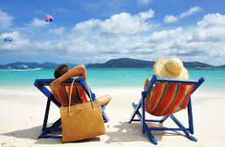
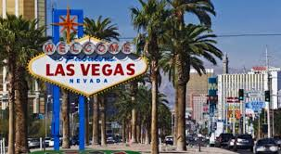
Conclusion:
Here you have these differences to consider when deciding where to go on vacation.

Slide 89
It is a fact that not all people have the opportunity to go on vacation. The ones who have the opportunity like to go out of town once in a while in order to leave their worries behind. When we go on vacation, we have to decide the best place to go according to what we have in mind. The purpose of this essay is to contrast the differences between vacation at a beach and in a city. We will look at the kind of activities, the clothing required and the pace of life available while vacationing on a beach or in a city.
Sample essay
to be continued

Slide 90
The first major difference between vacationing on a beach and in a city is the kind of activities you are able to do. On a beach, for example, you can go sailing, fishing, surfing, skiing, or take advantage of the sun and lie in the sand to get a tan, or even in some cases feed sharks and swim with dolphins. On the other hand, in a city you can visit different sites such as museums, theaters, important buildings, or go downtown. This means that you have many places to know and you will need much more time and organization in a city than on a beach.
to be continued

Slide 91
Another difference between vacationing on a beach and in a city is the clothing and equipment you need to take with you. If you decide to go to the beach, you will have to take mainly a bathing suit, shorts, short-sleeve shirts, sandals, sunglasses, and sun block. Considering that you are going to the city where you will have to walk a lot, you will need comfortable and casual clothing such as jeans and tennis shoes. You will also have to take fancy clothes in case you want to go, for example, to watch a play or to a concert.
to be continued

Slide 92
The final difference between vacationing on a beach and in a city is the pace of life. If you want a relaxing plan, your option will be the beach. When you are on the beach you just let things happen while in the city you will have to schedule all your activities in order to have time to visit the different sites you want to.
In conclusion, here you have these differences to consider when deciding where to go on vacation. Although both places are interesting and exciting, it all depends on what you are looking for. Keep in mind that wherever you decide to go you will enjoy it.
to be continued

Slide 93

Writing practice
Directions: Write an essay of no less than 200 words on one of the following topics. One topic has an outline that you can follow.

Slide 94
Topic: Continuing to study or going to work
Introduction: Choosing between continuing to study and going to work will have profound impacts on your future life and career.
Body:
Point 1: Your choice now will have an impact on your planning for the future. • continuing to study • going to work
Point 2: Your choice will also have an impact on your economic conditions. • continuing to study • going to work
Point 3: Your choice will, of course, have a great impact on your future job opportunities. • continuing to study • going to work
Conclusion:
You should be clear about all the possible impacts of your choice before you make the final decision.

Slide 95

More topics:
• Two fast-food restaurants
• Going to a movie or watching a movie at home

Slide 96


English Debate
Have a Debate on Job-hopping.

Slide 97

English Debate
The pros and cons of job hopping:
PROS
Diverse background.
Access to more information and resources.
Exposure to different businesses and people.
You’ll have a large, resourceful network.
A chance to find the right fit.
Higher pay.
…

Slide 98
English Debate
The pros and cons of job hopping:
CONS
An employer might see it as a sign of irresponsibility.
It may compromise your job security.
Lack of satisfaction.
You may damage relationships.
They may question your judgment.
They’ll fear you’ll leave at the first sign of trouble.
…

Slide 99


Translate a paragraph based on a summary of the text by using the expressions from the text.

Slide 100
如果人们的工作对自己有负面影响，但为了遵从社会的期望或者谋生而
被迫必须继续工作，那么他们就被认为是劳役者。如果人们的个人兴趣跟社会付酬让他们做的工作
相吻合，他们就被称为工作者。
adverse effect
conform to
feel compelled to
coincide with
To be continued

Slide 101
一份活到底应定为工作还是劳役并不取决于其本身，而是承担这份活的个人感受。工作者和劳役者的
区别在于他们对工作的态度、从工作中获得的个人满足感以及度过闲暇时间的方式。
be designated as
differ in
derive from
personal satisfaction
To be continued

Slide 102

不管你选择什么工作，都必须面对这个根本问题:“你想做一名劳役者还是工作者？”
contend with
essential question
Samples

Slide 103
People are considered laborers if their job has an adverse effect on them, yet they feel compelled to continue working by the necessity of conforming to societal expectations and earning a living. People are labeled as workers if their personal interests coincide with the jobs society pays them to do. Whether a job is to be designated as labor or work depends, not on the job itself, but on the tastes of the individual who undertakes it. Workers and laborers differ in their attitude toward their work, the amount of personal satisfaction they derive from their jobs and the way they spend their leisure time. Whatever job you choose, you must contend with this essential question: Will you be a laborer or a worker?

Slide 104



A
Will you be a worker or a laborer?
SECTION
Summary
Revision of
the Useful Expressions
Thematic study
Revision of
the Functional Patterns

Slide 105
Revision of
the useful expressions
Language points—useful expressions
1 受社会逼迫
2 严格说来
3 有负面的影响
4 遵从社会的期望
5 对立面
6 相吻合
7 有关联
8 更倾向于做某事
9 产生一种自豪感
10 谋生
feel compelled by society
in the strict sense
have an adverse effect on
conform to societal expectations
polar opposite
coincide with
correlate with
be prone to do sth.
foster a sense of personal pride
earn one’s livelihood

Slide 106
Revision of
the useful expressions
Language points—useful expressions
technological innovation
11 技术创新
12 大多数人
13 太多闲暇时间
14 名人八卦
15 奢华时尚
16 采取否定的态度
17 终身学习
18 投入激情
19 享受到最大的快乐
20 成就自我
the majority of the population
an abundance of leisure time
celebrity gossip
extravagant fashion
take a toxic attitude toward…
lifelong learning
hurl one’s passion (into…)
take optimum pleasure
personally fulfilling

Slide 107
Revision of
the functional patterns
Language points— functional patterns
Functions & Usages | Sentence Patterns
1. 用于表达“不同的人对待同一件事有不同的看法”。
2.用于举例说明“某人执着地做某事”。
3. 用于对比“ 不同人不同的做事风格”。
What is sth. from the point of view of A is sth. else from the point of view of B.
Sb. hurl the passion into sth. or doing sth., be it… like/such as…, or…like/such as …
But while A is doing sth., B is doing sth. else.
Notes:
上面挤，下面空

Slide 108
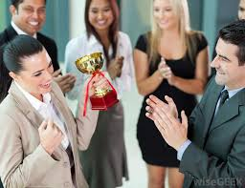

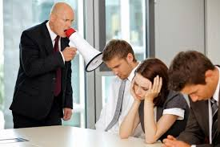
A
Will you be a worker or a laborer?
SECTION
The end

